Slide 1
SPFx: An ISV Insight to Microsoft’s latest customization model
By: Shai Petel

Slide 2
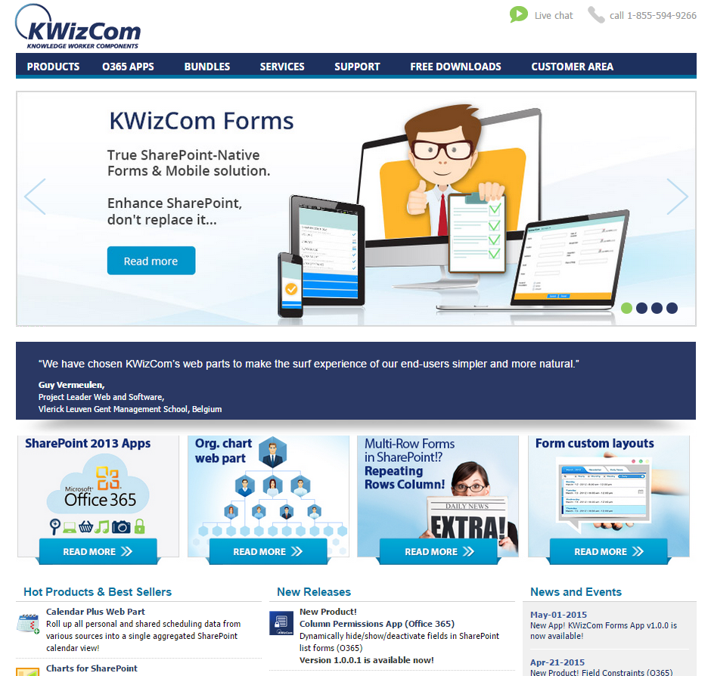
Notes:
KWizCom Corporation
Founded in 2005
Headquartered in Toronto
Global vendor of SharePoint Add-Ons
5000+ customers worldwide
Important thing to mention about KWizCom in the introduction (besides what’s written in the slide):
We have started developing add-on for office 365, so if anyone misses some functionality in that environment, please feel free to approach you or sales@kwizcom.com to discuss it (we LOVE gathering real needs from the community)

Slide 3
Shai Petel
Director of Research and Development at KWizCom
MCT, MCPD
6 times MVP: SharePoint (2011-2016)
shai@kwizcom.com | @shaibs | http://kwizcom.blogspot.com

Slide 4
Focus:
Publishing versions, upgrades
Pushing updates through CDN
Shared code and external libraries
Custom PropertyPane properties
Code, code, code.

Slide 5
Topics
SharePoint Development Models
What is SPFx?
Choice of UI framework
Building your solution
Publishing
External libraries
Shared reusable code
Consuming Data
Advanced PropertyPane
Development options
Updating SPFx framework
Other helpful tips

Slide 6
SharePoint Development Models
Overview of extensibility opportunities in SharePoint’s history

Slide 7
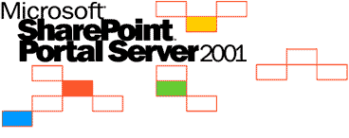


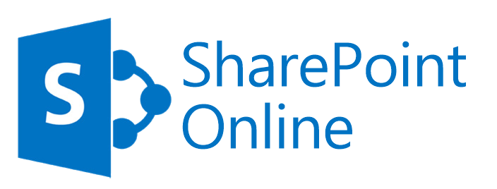



SharePoint Development Models
2001
STS
2003
SPS
2007
MOSS
2010
SharePoint Foundation
2013
SharePoint Foundation
SPO
SharePoint Server
2016
WSS
SPS
WSS
SharePoint Server
SharePoint Server
SharePoint Online
Group sites *
Notes:
STS – SharePoint Team Services
SPS – SharePoint Portal Server
WSS – Windows SharePoint Services
MOSS – Microsoft Office SharePoint Server
Group sites – SPO, different than regular SharePoint sites – more locked down, nocode.

Slide 8
SharePoint Development Models
2001
ASP (no, I didn’t forget the .Net)
Page parts, tokens (_wpq_, _wpr_)
No clear packaging and deployment
2003
Web parts (ASP.Net custom controls)
Packaged in CAB
2007
Features
WSP package
2010
Timer jobs
Sandbox
2013
SharePoint hosted apps add-ins
Provider hosted apps add-ins
JSLink / CSR
SPO
SharePoint hosted apps add-ins
Provider hosted apps add-ins
JSLink / CSR No code sandbox solutions
SharePoint Framework (SPFx)
Notes:
Full trust era
Non experienced developers could bring down the server
Developer heaven in terms of full control and unlimited options
Installation required access to the server, sometimes IISReset required
Add-ins
App parts in iframe was a bad idea
App web is too isolated, useless
Did not deliver on the promise to enable custom columns via JSLink / CSR
Provider hosted apps are hard to set up on premise
Sandbox
Was very restricted and did not deliver a powerful environment
App throttling was ridiculous (sorry, you used this web part too much today – come back tomorrow.)
No code version was only there to enable adding declarative buttons/CSS since the model was not scalable for the cloud
SPFx
Powerful runtime, integrated with your site
Full trust code, running under the user’s full permissions
Isolated by default (less risk of inexperienced developers using globals with conflicts)
Built using the powerful TypeScript, a worthy replacement for C#
SPO in mid-way dropped a bomb blocking JSLink and CSR support from add-ins requiring full-trust app permissions for them due to a security loophole.

Slide 9
What is SPFx?
Brief explanation of the SharePoint Framework

Slide 10
What is SPFx?
“a Page and Part model enables fully supported client-side development for building SharePoint experiences, easy integration with the SharePoint data and support for open source tooling development.”
Notes:
https://github.com/SharePoint/sp-dev-docs/wiki/Why-SPFx

Slide 11

What is SPFx? - advantages
Runs in the context of the current user. No iFrames
There is a life cycle that the developer is involved in
It is framework agnostic *
Open source tool chain
Performance
Solutions approved by the tenant admin (or their delegates)
Classic & modern pages
Can be used in noscript sites
Notes:
The controls are rendered in the normal page DOM.
The controls are responsive and accessible by nature.
It’s not just render, but load, serialize deserialize, configuration changes, etc.
React, Handlebars, knockout, angular – take your pick
The tool chain is based on common open source client development tools like npm, TypeScript, yeoman, webpack, gulp, etc.
Solutions can be used by end users on all sites after trusted by admins – even self service created sites like teams, groups, personal, etc.
Work on group sites (noscript required), as well as other sites without the need to disable noscript flag.

Slide 12

What is SPFx? - disadvantages
SPO: up-to-date - on prem: only 2016, older build
Extremely big learning curve
Limited artifact types supported
Publishing updates ~
No support for the app store
Notes:
On prem supported on 2016, older build which only has web parts.
SharePoint developers will get lost in the jungle.
Toolchain not very Microsoft-Dev friendly, no VS integration or project templates. But VSCode is amazing.
It is hard to build a complete solution in SPFx.
Missing lot of functionality: no custom column rendering, forms, mobile, etc
~ Admins will need to install updates of your application whenever you change your dependencies. Its not worst than before, but expected to be better.
Since these are full trust.

Slide 13
Does it deliver?
SPFx compared to previous generations
Notes:
Full trust is awesome – if you know what you are doing. Problem is, it was easy to build FTC in the wrong way.
Sandbox was a horrible concept – scalability and limit wise
Provider hosted apps – are only good for non-SharePoint applications that want to communicate with SharePoint, but the UX is not good since the user go outside of his SharePoint
SharePoint Hosted apps – were useless, since the web parts were in iframes and they didn’t deliver on the promise that they would enable customizing columns using JSLink
SPFx has all the right ingredients: rich, robust programming environment, client side API that is now been vetted and tested (still many things missing, but we make do), and it delivers the smooth integrated experience we were looking for.
Only thing missing is more artifact types like customize columns, list views, and add menu buttons which were all promised to join the framework.
Coming up are modern iteration of JSLInk, ScriptLink and CustomActions: https://github.com/SharePoint/sp-dev-docs/wiki/Release-Notes---Extensions-Dev-Preview-Drop-1
Also, it is used internally by the product team itself!
Which brings us back to the situation we had during the full trust era.

Slide 14
Choice of UI framework
How would you render the UI of your web part?

Slide 15
Choice of UI framework
SPFx is framework agnostic by design. Really?
This is the most important decision when building a new project
Notes:
Agnostic, yeah, but react is clearly the chosen one.

Slide 16

Choice of UI framework
ReactJS - the clear leader & first class citizen
This is the engine MSFT use themselves
The PropertyPane is built on react, and the engine wrapping your WebPart is too.
The only Office UI Fabric components actively supported by Microsoft

Slide 17

Choice of UI framework
KnockoutJS
Good when you need dynamic templates (i.e. user supply / customize HTML output)
Lack of fabric components. Use FabricJS
Building in --ship mode removes KO comments
Notes:
FabricJS –very buggy, globals will conflict. See KWizCom’s take on fabric JS later in this slideshow.

Slide 18


Choice of UI framework
Handlebars, angular, etc…
Experiment, choose the one that fits your skills and needs.
AngularJS has a good community supported
office UI fabric components library.

Slide 19
Building your solution

Slide 20
Building your solution
Building a new project
Create a folder
Run “yo @microsoft/sharepoint”
Set name, description

Slide 21
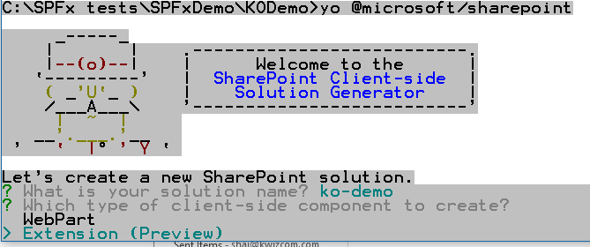
Building your solution
Building a new project
Select “WebPart”

Slide 22
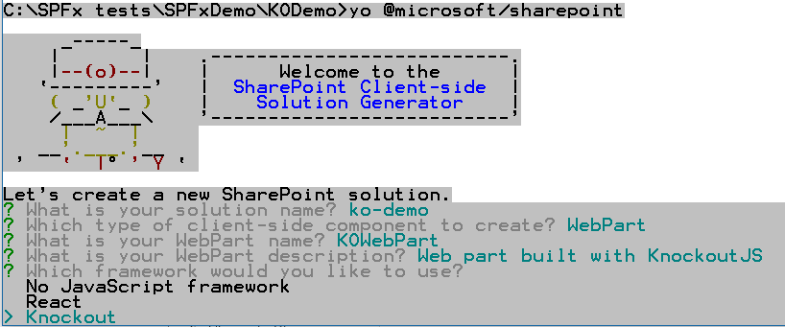
Building your solution
Building a new project
Select your JavaScript framework

Slide 23
Building your solution
Add several artifacts to a single package
Currently only web parts are supported on prem
Application Customizer, Field Customizer and ListView Command Set – very limited & online only
Add more artifacts by running “yo @microsoft/sharepoint” inside an existing project folder
Notes:
SPFx package can hold several artifacts inside
More types will be coming to production soon
A single web part can have more than one declaration with different default value. See react web part sample.
Limitations:
Field customizer – only works in list view. missing new/view/edit form support.
Application customizer – loads only after the entire page content finished loading. You can basically have a JS file do what ever you want on the DOM but might be too late at this point if you want to hide stuff or re-order.

Slide 24
Publishing
Publishing your SPFx solution

Slide 25
Publishing
Content Delivery Network (CDN)
Specify CDN in config/write-manifests.json
Host script files, css, images, html
Push minor fixes to clients
Non-ISVs on SPO can use Office 365 public CDN
Notes:
Before publishing your project, you must set up a CDN
Script files and other resources (CSS, image, html templates, etc.) can be served from your CDN so that you can control caching, global reach, etc.
You can push minor fixes to your server, as long as you do not change the dependencies your package requires. (import / require statements)
https://dev.office.com/blogs/office-365-public-cdn-developer-preview-release
Why Office 365 is for non ISVs? ISVs might benefit from having all customers point to one origin, so that they can push updates automatically in some cases without requiring customers to install a new package manually.
As of SPFx 1.4, includeClientSideAssets flag (on by default) negate the need for a CDN and will bundle up all artifact and deploy them automatically to your SPO CDN library or app catalog site if CDN option is not turned on.

Slide 26
Publishing
Control production build file names
Running gulp --ship will produce a bundle file for production:
Default: react-web-part.bundle_a4b2ffc1a3b03f7ce4b5bd78bdd7ac62.js
Recommend: react-web-part.1.0.0.0.js
Notes:
You might want to control the output file name of your project when you build for production (gulp --ship)
By default, SPFx builds a hash for the bundle file and append it to the file name. This means on every change you will have to rebuild and publish a new version of your project.
If you want to be able to push minor fixes to your CDN and reach your clients, you should consider changing this.

Slide 27
Publishing
Publish a package
Update web part version in config/package-solution.json
Run gulp --ship
Go to temp/deploy folder
Rename the JS file (I use {project}.{version}.js)
Edit the json file: replace the bundle JS file to the new name *
Run gulp package-solution --ship
Take your new packages from the SharePoint/solution folder
Drop your new JS to your CDN **
[optional steps]
Notes:
* Note: this can be automated by overriding the build steps, like many other things but I have yet to find a way to do it.
** You only need the JS file in your CDN. Not the JSON file.

Slide 28
Publishing
Publishing updates: Do I need to release a new package?
You might be able to push updates to your customers
Check if your new version is backward compatible
Track version via a static variable
Notes:
BuildVersion is a static variable in your own code. You manage it and it helps you keep track of the runtime version when testing or reporting issues.
I prefer a simple number I increment whenever I build in release, but it can be anything.
I recommend writing it using console.log to help you find it quickly when checking an issue.
Imagine you have a critical bug, or a typo, and just want to fix that. You push your minor fix to your CDN, and expect it to be fixed for all customers.
But, if you publish it as a new version – your customers will not see it until they update the package in the catalog.
The nice thing is – they don’t have to update it in each and every site, once updated in the catalog it will work.
Make sure you keep older packages JS files in your CDN since you don’t know when customers will update. Consider sending an alert for users “a new version is available”.

Slide 29
Publishing
Publishing updates: Update a package
When a new package is needed – follow “publish a package” steps
When a new package is not needed
Update BuildVersion in your code *
Run gulp --ship
Go to temp/deploy folder
Copy the new JS file content into your existing file on your CDN
To use your own minifier, drop the --ship flag, take the file from the dist folder

Slide 30
Publishing
Installing / upgrading package
Upload package to the App Catalog
Trust the app
Fixed? A new version: delete old package first
Notes:
You should be prompted to trust the app, this will trust the app at the tenant level, and won’t require each user who is adding the app to his site to re-trust it
https://github.com/SharePoint/sp-dev-docs/issues/550
There is a bug right now with overwriting the package in the app catalog. Recommended to delete the older version first before uploading the new once.
Despite being told several times that the bug in overwriting the package was fixed, I could still observe it when using 2 or more browser windows.
Still, the most reliable way is to delete it first and then upload the new version.
Perhaps this is really fixed this time – verify.
Once uploaded, all sites should start using the new version – you won’t need to update each and every one manually.

Slide 31
Development options
Dev time environments and options

Slide 32
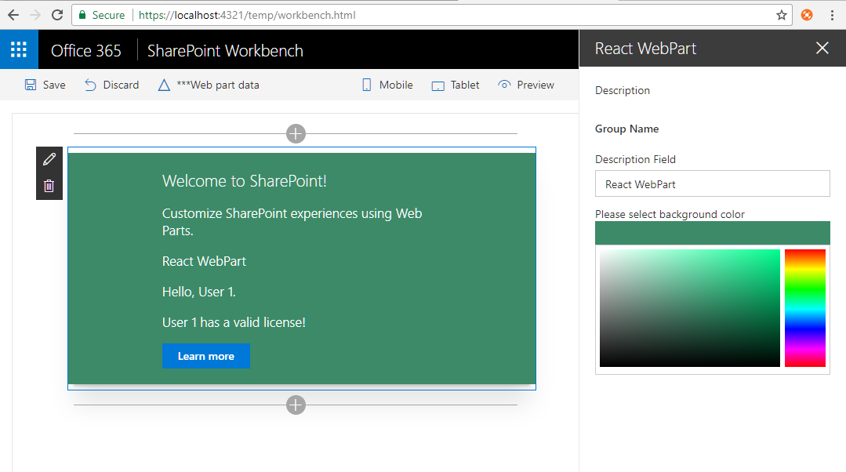
Development options - local workbench
gulp serve https://localhost:4321/temp/workbench.html
Notes:
Very nice for demos and playground, mainly while building the UI with mock data
Useful for automated tests
Super fast, responsive
Good debug experience, can get all map files and debug TS files directly.
Debug in VSCode: install ‘VS Code – Debugger for Chrome’ https://marketplace.visualstudio.com/items?itemName=msjsdiag.debugger-for-chrome
From my experience: not recommended at all, since the online workbench has all the same benefits plus more.

Slide 33
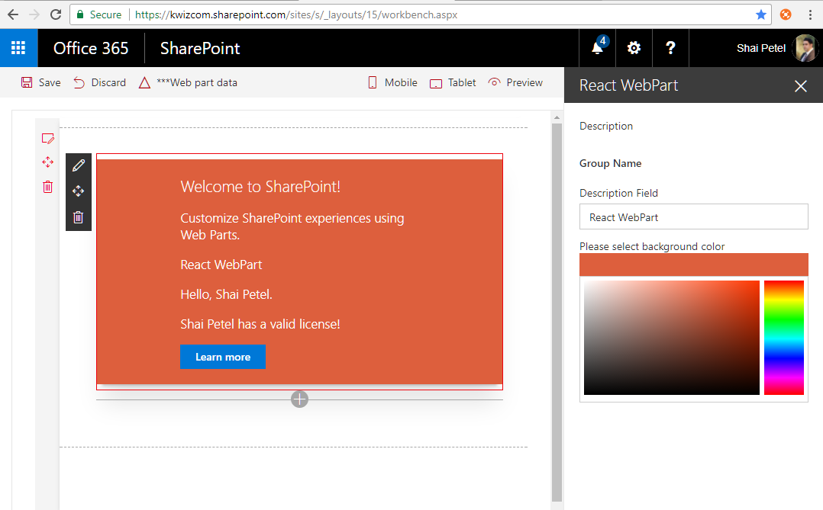
Development options – online workbench
gulp serve --nobrowser
{spo site}/_layouts/15/workbench.aspx
Notes:
All the benefits of the local workbench
Connected to your site, so you have a valid SharePoint context.
Cannot save the page, so I also recommend testing every version you are about to ship against a classic/modern with a saved web part from previous release (see later why).
Recommended for dev time, and unit testing.
Note: if you added the published app to this site, as of 1.4 you will not be able to use the workbench on that same site. You will need to use the workbench on a different site.

Slide 34
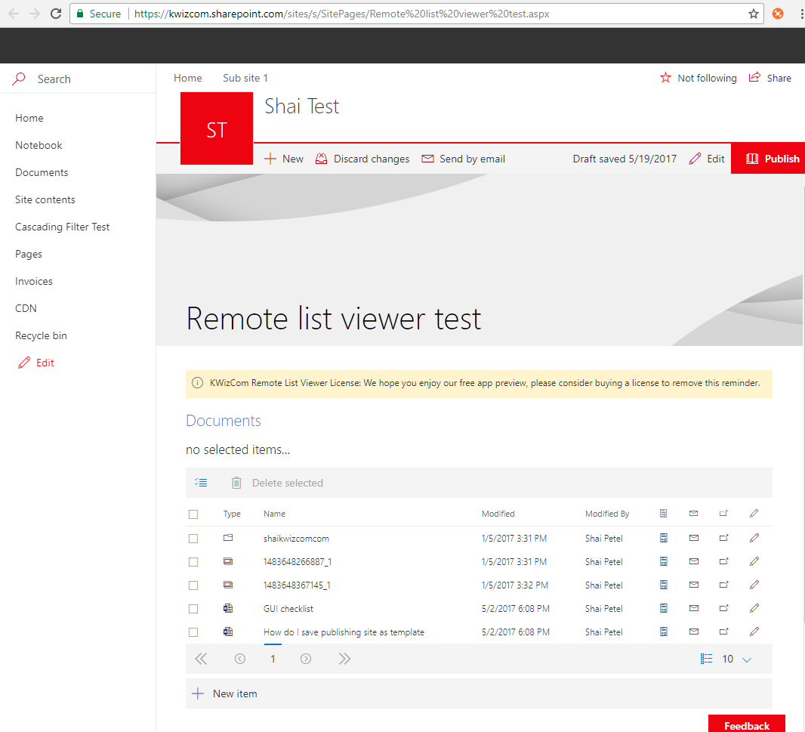
Development options – classic/modern page
gulp --ship
gulp package-solution --ship
Publish to CDN
Deploy to catalog
Add app to your site*
Notes:
takes time and you must publish the app to catalog, add it to your site and then add the web part to your page.
Get the exact experience your end users will have, along with an option to save the web part.
Why is this important? Your web part will be loaded with all dependencies sent to it with private names. If your code changes and your web part now requires a different set of dependencies (a using/import was added/removed) – the signature will change. At this point your web part will stop working and require you to publish a new web part to the catalog with the correct signature that matches these dependencies.
Production requires use of CDN to host your files. You will lose your TS debugging options when building in production.
* From my experience, you can skip step 5 if you already added the app to your site. apps are updated in all your sites where used automatically.

Slide 35
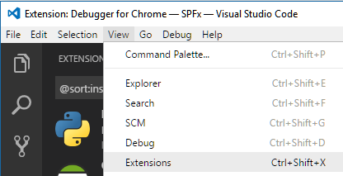
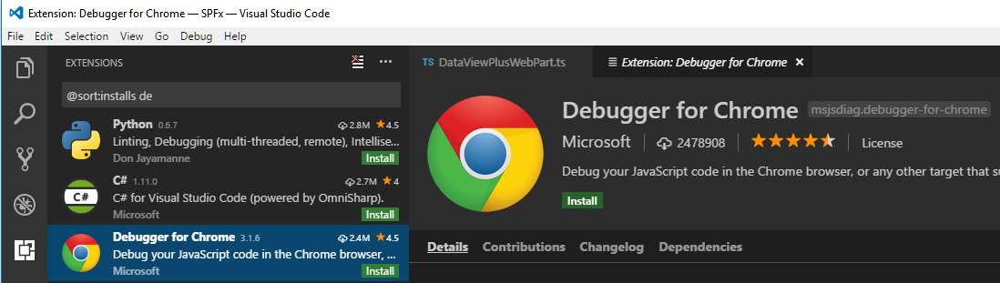
Development options
Debugging using VSCode in Chrome
Open VSCode, View->Extensions
Install “Debugger for chrome”
Notes:
For non-production built packages, or for workbench.

Slide 36
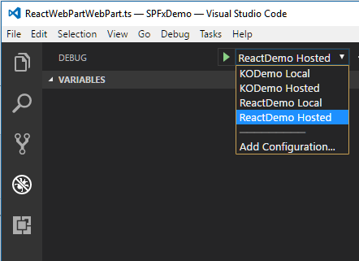
Development options
Debugging using VSCode in Chrome
Create launch.json
Select your configuration
Start gulp serve --nobrowser
Press F5
Notes:
Create multiple configurations in launch.json, for each project in case you have multiple
After gulp serve is running, select the right configuration and press F5
Debugger will start its own controlled browser
Note: if your project is in a sub folder, modify the “webRoot” in the JSON file accordingly.
https://dev.office.com/sharepoint/docs/spfx/debug-in-vscode

Slide 37
Dependencies
Using npm modules
External dependencies
Legacy script (global)

Slide 38
Dependencies - npm
Bundling npm modules
When you wish to use an npm available module
If it is a small file, and not reused across many different components
* Bundling includes this entire module inside your JS file.
Notes:
Bundling: means the content of the module JS will be copied entirely into your package JS bundle file.

Slide 39
Dependencies - npm
How?
npm install {package} --save
tsd install {package} --save (or create your own typings {package}.d.ts)
In your web part code:
import * as {object} from ‘{package}’
import {object} from ‘{package}’
Notes:
Alternatively, add it to your package.json and run npm install. This basically does the same as the --save flag.

Slide 40
Dependencies - npm
External npm modules
When you wish to use an npm available module
If it is a large file, or reused across many different components
* External modules will be loaded from a CDN

Slide 41
Dependencies - npm
How?
Follow previous steps to load the npm module
Mark this module as external, to prevent bundling:
Edit config/config.json
Add this under “externals” object:
“<package>”: “{path to js file}”
Notes:
For legacy modules that use a global object:
“<package>”: {“Path”: “{path to js file}”, “globalName”: “<global>”}
* You might also want to create a typings file for libraries that don’t have them.

Slide 42
Dependencies - npm
Important!
.gitignore excludes node_modules folder
run “npm install” when moving computers
Dependencies change and your project may break as a result - npm shrinkwrap!
Notes:
Consider backing up node_modules folder on a version that was working.
Don’t recommend adding it to every SPFx project, but maybe add it to one “sanity” project, but removing .gitignore file.
If (when) the time comes and your project fails to build, you can compare dependency versions between your latest working version of “sanity” and the versions that break.
More info: http://kwizcom.blogspot.ca/2017/07/spfx-project-breaking-after-moving-to.html
Run npm shrinkwrap to keep the entire dependency tree of npm packages so that you know when other devs use it and run npm install they get exactly the same packages as you do.

Slide 43
Dependencies – global library
Loading a legacy script file using config.json
When you want to load an external script file from a CDN
Add it as an external (with a global declaration if needed)
Import it in your web part
Optionally, create typings for your global. module declare ‘extLib’{…}
Alternatively, you can declare it as type any: declare var extLib: any;
Notes:
https://dev.office.com/sharepoint/docs/spfx/web-parts/basics/add-an-external-library
Edit config/config.json
Add this under “externals” object:
“<package>”: {
“path”: “<path to js file>”,
“globalName”: “extLib”, “globalDependencies”: []
}

Slide 44
Dependencies – global library
Loading a legacy script file programmatically
When you don’t want to change your package signature, or when you want to load it conditionally
When loading an external script file from a CDN

Slide 45
Dependencies – global library
Loading a legacy script file programmatically
How?
Declare its global:
declare var kwfabric: any;
Use a promise to load it, execute your code once the promise resolves:
SPComponentLoader.loadScript(`https://apps.kwizcom.com/libs/office-ui-fabric-js/1.4.0/js/fabric.js?prefix=kw`, { globalExportsName: 'kwfabric' }).then((p: any) => {
//use kwfabric
});

Slide 46
Dependencies –fabric js
Using Office UI Fabric JS
If you can, use react. It comes with amazing support for Fabric UI.
If not, I recommend using Fabric JS.
Optionally, use KWizCom’s hosted branch of Office UI Fabric JS:
http://kwizcom.blogspot.ca/2017/03/using-office-ui-fabric-js-in-spfx.html
Notes:
Fabric JS has many bugs and quirks, and missing features. Also, it registers global objects and global CSS files that might collide between versions.
The best way around that, is to create your own branch, and use your own prefix.
KWizCom offers our own version to the public, that is isolated from other versions, plus maintained by our R&D for bug fixes and additional functionality. It is accessible from here: https://apps.kwizcom.com/libs/office-ui-fabric-js/1.4.0/js/fabric.js?prefix={yourprefix}
Feel free to load it, using your own prefix. When we publish new versions, you can create a new prefix to keep them isolated and working side by side on the same page.

Slide 47
Shared reusable code
Reuse your code between different SPFx projects

Slide 48
Shared Reusable Code
Create folder for your shared code
If you plan to use type script
Use your code relatively to your project folder
Notes:
One issue: since SP core classes are not installed globally, you might have to use any types to avoid type mismatch errors when using the same code in 2 or more projects, especially if they each use different SPFx build version
Once you edit/change your code, you will need to run tsc to re-compile your scripts.

Slide 49
Shared Reusable Code
Create folder for your shared code
If you plan to use type script
Install dependencies manually: npm install @microsoft/sp-core-library@~1.4.0 npm install @microsoft/sp-webpart-base@~1.4.0
add tsconfig.json, run tsc to compile
Use your code relatively to your project folder
Notes:
One issue: since SP core classes are not installed globally, you might have to use any types to avoid type mismatch errors when using the same code in 2 or more projects
Once you edit/change your code, you will need to run tsc to re-compile your scripts.

Slide 50
Shared Reusable Code
Create folder for your shared code
If you plan to use type script
Use your code relatively to your project folder
import Utilities from '../../../../SharedCode/Utilities';
Notes:
One issue: since SP core classes are not installed globally, you might have to use any types to avoid type mismatch errors when using the same code in 2 or more projects
Once you edit/change your code, you will need to run tsc to re-compile your scripts.

Slide 51
Shared Reusable Code
Consider creating an npm package
Benefits: great versioning and manageability
Disadvantages: overhead in managing the package and publishing updates
Notes:
Publish it as a private or public NPM module, to GitHub, or to a local folder relative to your project
Consume it as any other NPM module, using declaration in package.json file

Slide 52
Shared Reusable Code - npm
Creating a new package
Run “npm init”
Edit package.json, add dependencies
run “npm install”
If you plan to use type script:
Add tsconfig.json
Run tsc to build JS files from TS
Specify "typings" in your package.json
Notes:
In react demo it is defined as external. In KO bundled.
See how content comes into ko bundle file and not to react?
See how react web part loading it from CDN (and not working in local workbench)?
Package name must be lower case only, use – as separator
Author format: name <email> (web site)
License: specify in a separate file: “SEE LICENSE IN <filename>”
Instead of editing package.json manually, consider using “npm install {package}@{version} --save“ flag

Slide 53
Shared Reusable Code - npm
Using your new package
Edit SPFx package dependencies, add your package: "kwizcom-license": "file:../kwizcom-license“
Bundled by default, should you mark as external?
Plan on using this package from several different projects?
Its JS file is large?
How?
Edit config/config.json add to externals: "kwizcom-license": https://kwizcom.sharepoint.com/sites/s/cdn/License.js
Now, you can also push minor updates/fixes without having to re-publish all your projects (when you keep backward compatibility).
Notes:
In react demo it is defined as external. In KO bundled.
See how content comes into ko bundle file and not to react?
See how react web part loading it from CDN (and not working in local workbench)?
When pushing shared package updates to CDN, be sure to consider full backward compatibility. Otherwise, version your publish.

Slide 54
Shared Reusable Code - npm
Publishing updates?
Update version number in package.json
Run “npm update” everywhere you used it to update the package
Notes:
In react demo it is defined as external. In KO bundled.
See how content comes into ko bundle file and not to react?
See how react web part loading it from CDN (and not working in local workbench)?

Slide 55
Consuming Data

Slide 56
Consuming data
Connecting to data
SharePoint
Microsoft Graph
* Local workbench not supported

Slide 57
Consuming data
Requesting SharePoint content
Use SPHttpClient (this.context.spHttpClient) post/get to make rest requests
Load JSOM into your SPFx
DO NOT try to use the JSOM global objects. No one guarantees they will be there in modern pages/other pages.

Slide 58
Consuming data
What is Microsoft Graph API?
Graph API is a rest end point for all of your users O365 services.
This includes access to his OneDrive, Mail, Calendar, Contacts, SharePoint, and the list goes on.

Slide 59
Consuming data
Requesting Graph content
Today – do it yourself. Register an application for graph, request the trust/permissions you need, and make rest requests.
Soon – Microsoft will share one token/key we can all use for basic read access
Use GraphHttpClient/MSGraphClient (preview)
Will automatically use a shared available key/token, with limited set of permissions
This token will be limited to accepting requests ONLY from SharePoint online hosted sites, as a security measure.
Notes:
https://developer.microsoft.com/en-us/graph/graph-explorer
Example: SharedCode/Utilities.ts, KODemo
Note: not supported on local workbench either

Slide 60
Advanced PropertyPane
What can you do with the PropertyPane?
Building custom controls

Slide 61
Advanced PropertyPane
Basic concepts
Rendered based off a dynamic JSON definition object.
The tool part will re-render when changing a dropdown value, or when clicking a button.
When a property changes, it will update your web part by re-calling the “render” event.
Basic structure:
Pages -> Groups -> Properties -> Property
Notes:
JSON object can change and re-render the property pane to reflect changes.
This allows you to add, remove or change properties, sections and pages in the PropertyPane.
You can also dynamically load the options of a drop down control by changing the definition of that control in the JSON object.
Changes in properties re-render your web part, which allow your web part to update the UI and be reactive to the user changes. If your render method takes time, you might want to turn off reactive mode to disable this.

Slide 62
Advanced PropertyPane
Advanced concepts - Validations
onGetErrorMessage return error message string, or function returning promise.
During validation, you can control and change other properties.
In most cases, it is best to fire on change event to notify SharePoint of the change.
Notes:
For more advanced validations, depending on other properties, and affecting/changing other properties, it can be a function that returned a promise. You must resolve the promise with empty value for valid or error message for invalid.
Note: if you return an error message for invalid field, as soon as the user leaves that field control his value will be reverted to the last valid value. This can be a big problem if the user needs to change another field before his current field becomes valid.

Slide 63
Advanced PropertyPane
Advanced concepts - Custom controls
You can create your own controls for the property pane
Use the render method to render your own controls
Get configuration info from the web part, such as context, label and where to store your values.
Notify the web part on value changes (You will need to create that logic – see next slide)

Slide 64
Advanced PropertyPane
Advanced concepts - Trigger on change
First, add the two helper function:
import { get, update } from "@microsoft/sp-lodash-subset";
Create a handler for your property “on change”
private onPropertyChange(propertyPath: string, newValue: any): void {
const oldValue: any = get(this.properties, propertyPath);
update(this.properties, propertyPath, (): any => { return newValue; });
this.onPropertyPaneFieldChanged(propertyPath, oldValue, newValue);
if (!this.disableReactivePropertyChanges)
this.render();//update the webpart
}

Slide 65
Advanced PropertyPane
“this.properties” will get serialized and saved when your web part is saved. No matter how or what changed its value.
Write your own designer logic: popup, panels or inline. Show it when your web part is in edit mode: if (this.displayMode === core.DisplayMode.Edit)
Notes:
The PropertyPane logic can be very confusing to users, especially in classic pages. They do not integrate well with the classic web part properties.
It is, then, up to you to decide if you want to use the SPFx PropertyPane, or build your own configuration experience.

Slide 66
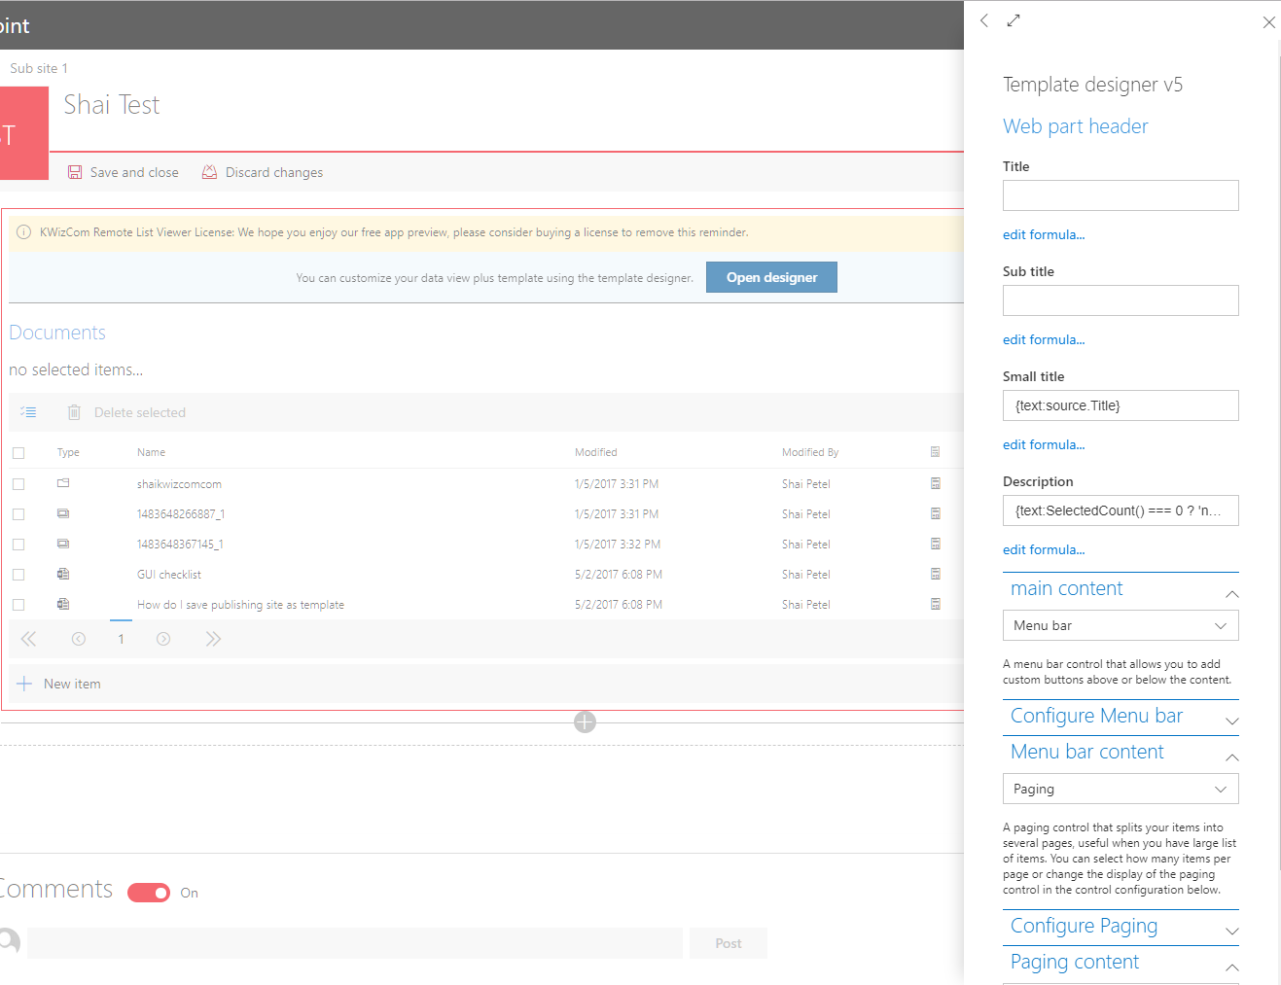
Advanced PropertyPane
Example: custom designer

Slide 67
Updating SPFx framework
How to get updates to SPFx?
Notes:
This would not normally be an issue, since how many of us installed updated to previous VS Tools for SharePoint?
Except, this time around Microsoft shifted to releasing half baked early versions, while adding more features and updates regularly.
So, I suspect updating the framework will become more popular, and the experience isn’t great.

Slide 68
Updating SPFx framework
Upgrading SPFx version is a challenge
Pre-GA, it meant building a new project and moving your code
Promised this will stop after GA *
Notes:
We have yet to see how updates will be delivered into existing projects, currently it is a lot of manual editing, very error prone
See issue with chrome v58 self signed certificate was very complex to get the fix long after it was published:
https://github.com/webpack/webpack-dev-server/issues/854
Simply updating your yeoman generator doesn’t help existing projects. You need to manually edit your project or create a new one and move your code to it. This would create a version history nightmare in the long run.
* While upgrading is much better now, it is still far from perfect and in many cases still requires building a new package in the new version. Ex: http://kwizcom.blogspot.ca/2018/04/upgrading-spfx-react-from-110-to-140.html

Slide 69
Updating SPFx framework
Dependencies
In theory, as simple as updating package.json and running npm install/update
In practice, involves a lot of praying, occasionally deleting node_modules, and dealing with unexpected errors in dependencies
Some dependencies are still global, but that will pass
Notes:
version mismatch, missing/wrong typings, etc.
Example: Fabric UI Core classes were updated and later pulled after they broke many web parts. Read more: https://github.com/SharePoint/sp-dev-docs/issues/325#issuecomment-315683738
The process is very hard to debug in some cases, involves reading many lines of errors in the console output.

Slide 70
Other helpful tips

Slide 71
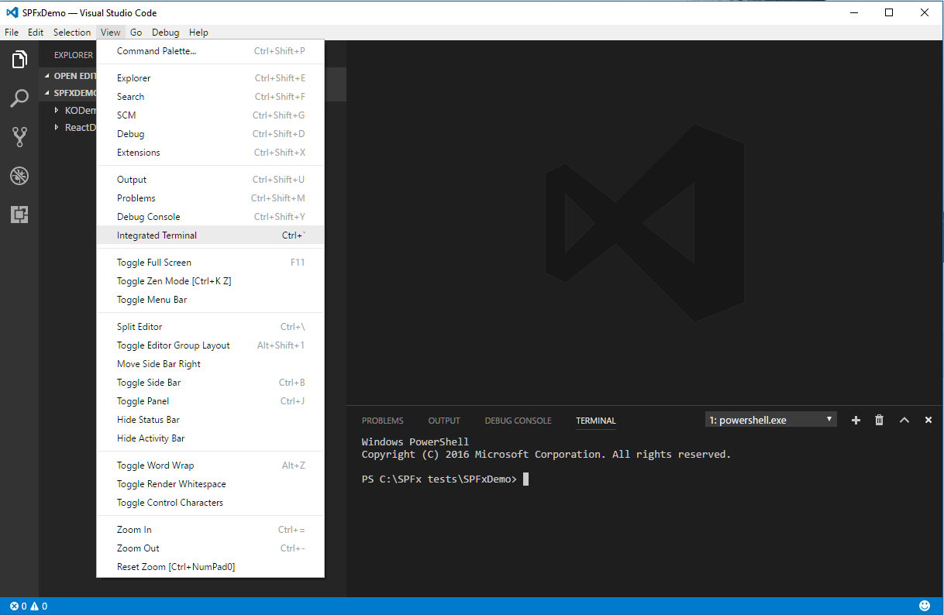
Helpful tips
Open integrated terminal in VSCode

Slide 72
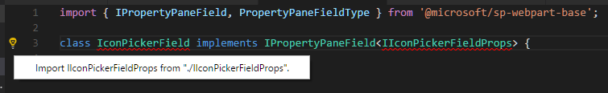
Add import statements
You don’t have to type the import yourself, look for the yellow bulb icon when standing on an unrecognized element:

Slide 73
Helpful tips
Delete/exclude node_modules from your source control / when zipping the project.
Demo project size:
646MB, 86K files.
Without node_modules:
1.75MB, 138 files.
Notes:
You can always restore them using npm install, if you are using packages.
Only down side, if you are using a package that got unpublished, you might not be able to restore it. But that is pretty rare, and probably means you shouldn’t use that package anymore anyways.

Slide 74
Helpful tips
Get used to memorizing commands…
gulp = build
gulp --ship = build in production
gulp trust-dev-cert/untrust-dev-cert = trust the local certificate
gulp package-solution = create package
gulp serve = start local server
code . = open VSCode in current folder

Slide 75
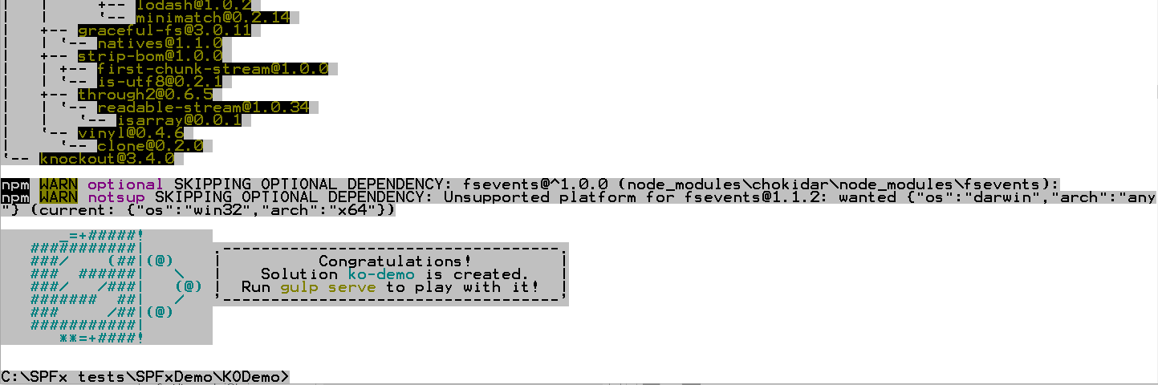
Helpful tips
Get used to seeing warnings in the output of the different commands, especially npm-install.
Errors – you should resolve or something will be broken.
Warnings during build (gulp) may come from your code so you should fix these (missing semicolon, unneeded import, etc)

Slide 76
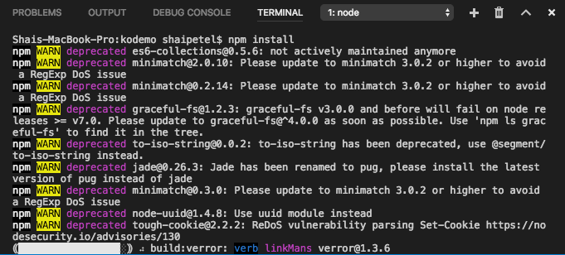
Helpful tips
Notes:
Safe to ignore, although very disturbing.

Slide 77
Questions?
follow up:
shai@kwizcom.com
kwizcom.blogspot.com

